Slide 1
Progress update
2020. 06. 08.
Yeonjae Kim, Kyuyeon Kim, Hyeongyeol Ryu

Slide 2
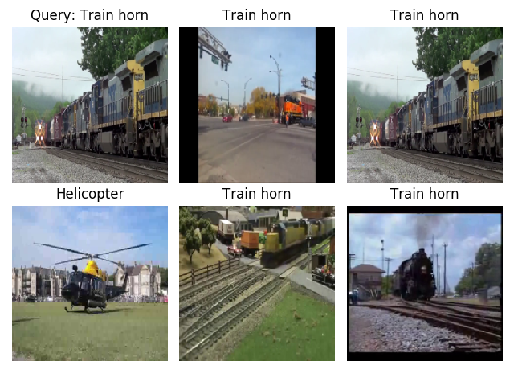
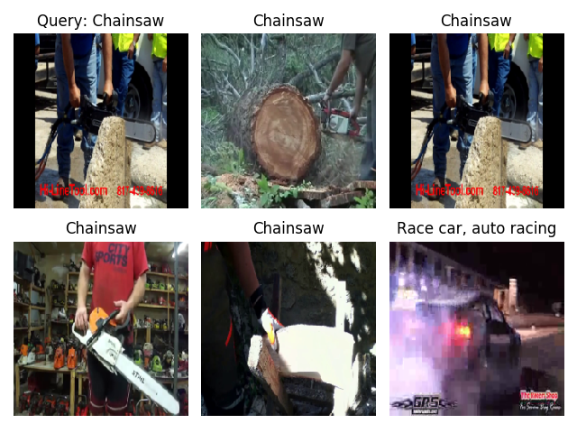

Hook
Preview of our replication model
Audio to Image
Image to Audio

Slide 3
Introduction
Cross-modal Learning – concept and problem
Approach – What we did and what we will do
Dataset – What we used
Replication
Faced Problems and solutions
Setting
Experiment Result
Performance
Experiment results
Improvement
Improvement(+feedback)
Plan for improvement
Contents

Slide 4
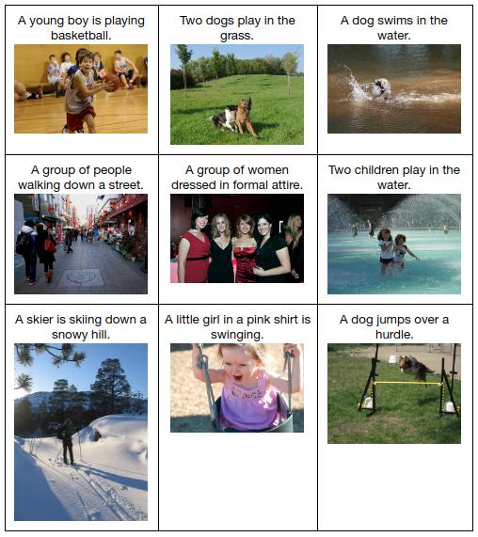
Cross-modal Learning
Image
Audio
Text
Learning with data having different sources
Example of cross-modal learning

Slide 5
Problem
Limitation of cross-modal learning works
supervised learning, or teacher-student supervision.
Require labeled dataset.
Research question
self-supervised audiovisual learning for cross-modal retrieval and sound localization on image

Slide 6
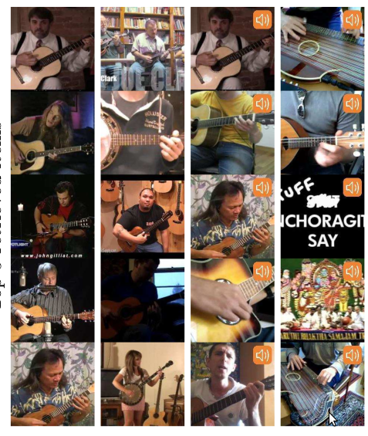
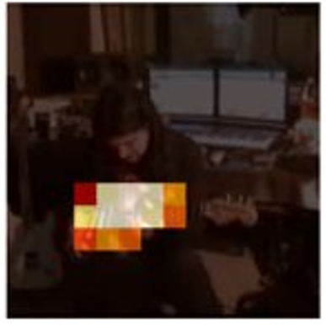
Objects that sound (ECCV 2018)
Cross-modal retrieval (e.g. audio query → retrieve images which are related to it).
Sound source localization
Given query
Retrieved items
Cross-modal retrieval (AVE-Net)
Sound source localization
(AVOL-Net)

Slide 7
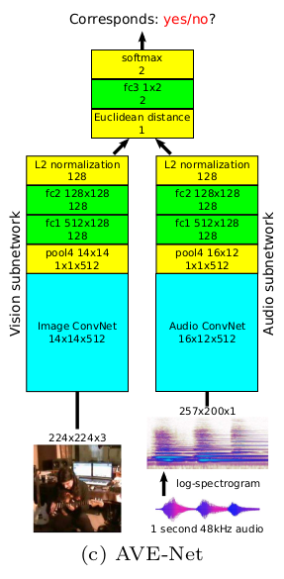
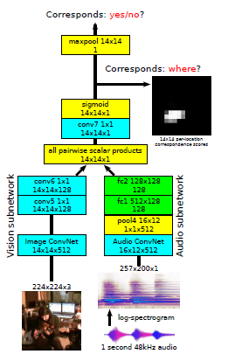
Approach
Try different
Object classes
Data configuration
Analysis
AVE-Net
AVOL-Net
Spectrogram (visual representation of audio)

Slide 8
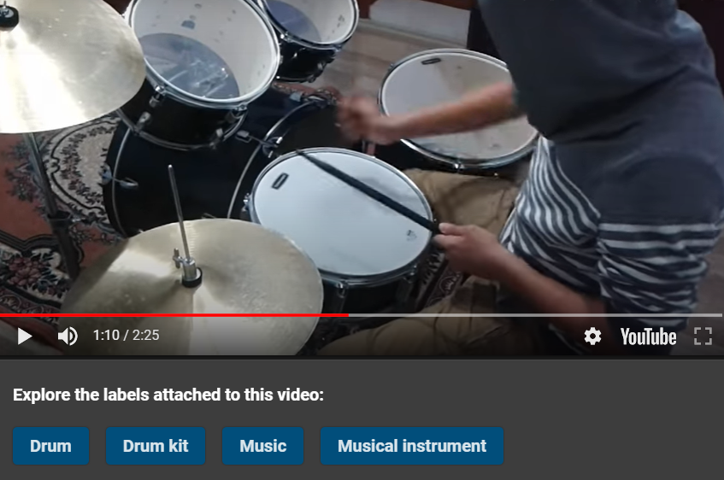
Dataset
Example of AudioSet
Original dataset: AudioSet, AVE-dataset
Used classes: Musical instruments, animal, human voice, …

Slide 9
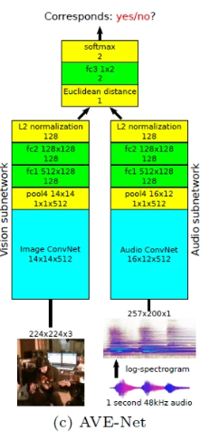
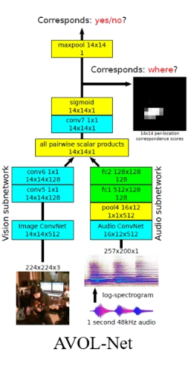
So, what was our goal
Reproducing AVE-Net, AVOL-Net.
AVE-Net
Audiovisual correspondence predictor.
Learn to represent good embedding by learning the correspondence.
Cross-modal retrieval.
AVOL-Net
Sound localization by learning the correspondence.
AVE-Net
AVOL-Net

Slide 10
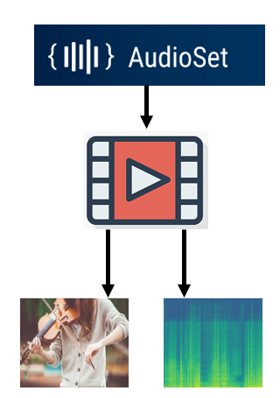
What have we done so far
Dataset download.
Video processing.
Implement data feeding pipeline.
Implement network.
Successfully trained AVE-Net.
Analyze performance of AVE-Net.
What problems have we faced?
Performance
Evaluation
Accuracy
Cross-modal
retrieval

Slide 11
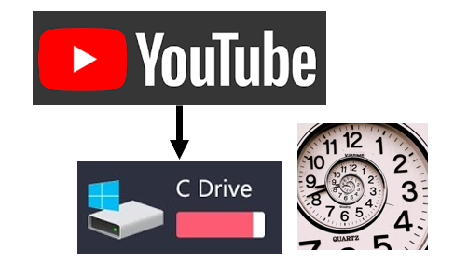


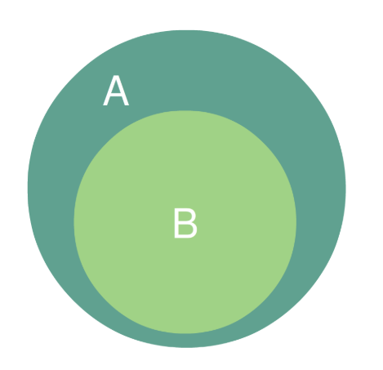


Faced Problem 1: Obtaining video
IP ban (HTTP 429 Error)
Obtaining video is time consuming, needs lost of disk space.
Solution
Solution
Use subset of what author used.
Give some delay between different download.

Slide 12

Faced Problem 2: Data Feeding Pipeline
AVE-Net
DataLoader
Extracting image and spectrogram directly from raw data creates bottleneck.
Preprocessed all videos and saved images and spectrograms into numpy arrays.

Slide 13
Faced Problem 3: Model is sometimes not being trained!
Learning rate was not small enough.
0.0001 (1e-4) → 0.00005 (5e-5)
Last fully connected layer initialization.
Initialize fc3 with different method.

Slide 14
Basic Settings
 | Ours | Paper
Train / Val. / Test size | 48k / 6k / 6k | 230k / 30k / 4.3k
Batch size | 64 | 2,048
Learning rate | 0.00005 | Unknown
Optimizer | Adam
Weight decay | 0.00001
Epoch | 300 ~ 400 | Unknown

Slide 15
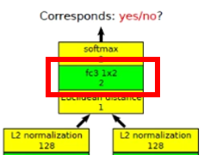
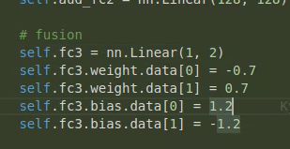
Settings
Give different sign values in weights of fc3
Different initialization method on fc3.
Strict vs. Unstrict negative pair sampling
Positive: Video frame and audio come from the same video, same timing.
Unstrict negative: Video frame and audio come from different video. (Harder negative)
Strict negative: Not only different video, but should also have different tags. (Easier negative)

Slide 16
4 different settings
FC3 different initialization + Strict negative
FC3 different initialization + Unstrict negative
No FC3 different initialization + Strict negative
No FC3 different initialization + Unstrict negative

Slide 17
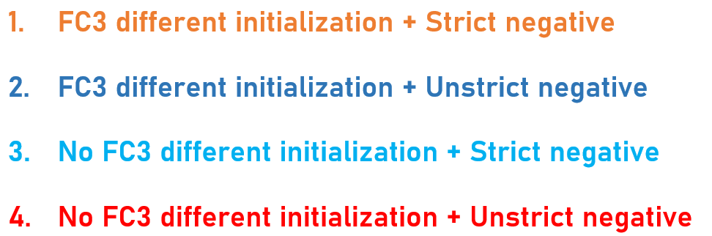
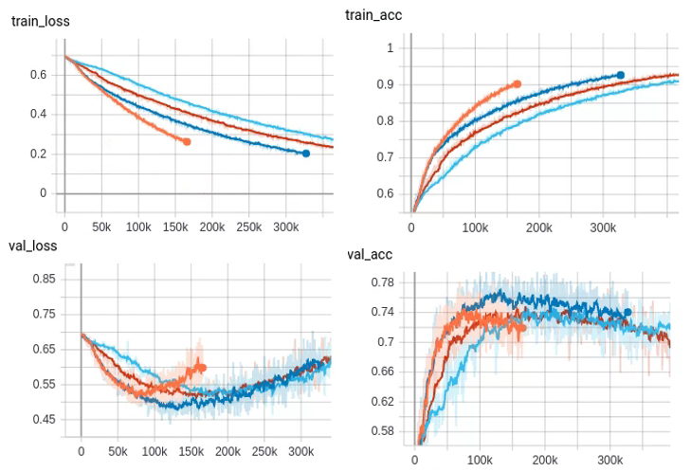
Performance
Test setting | Test accuracy
1 | 73.2%
2 | 76.9%
3 | 74.4%
4 | 75.1%
Performance of AVE-Net in the paper: 81.9%
x-axis: batches trained

Slide 18
Did & To do
Did
Get dataset & preprocess
Train AVE-Net
Analyze performance (accuracy, qualitative cross-modal retrieval result)
To do
Analyze quantified performance of cross-modal retrieval result (nDCG@K)
Train AVOL-Net. (Sound localizing network)
Visualize the performance of AVOL-Net.

Slide 19
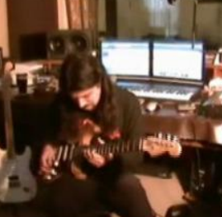
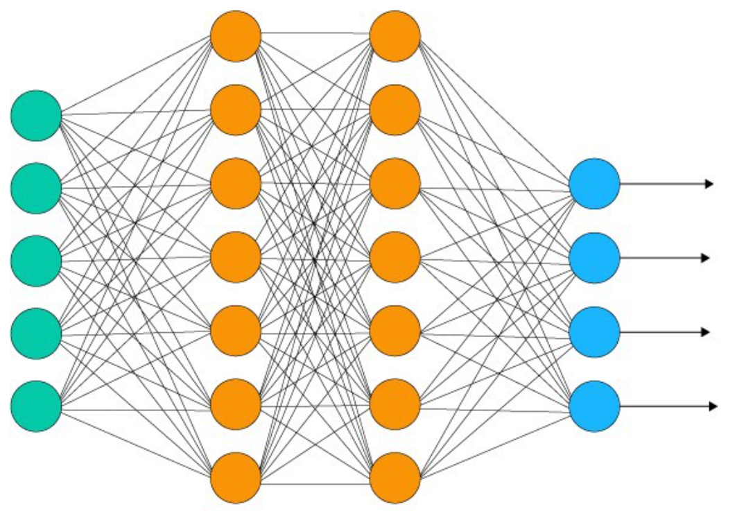
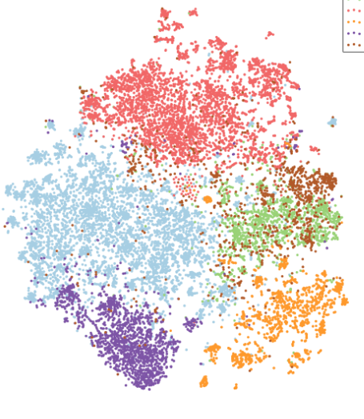
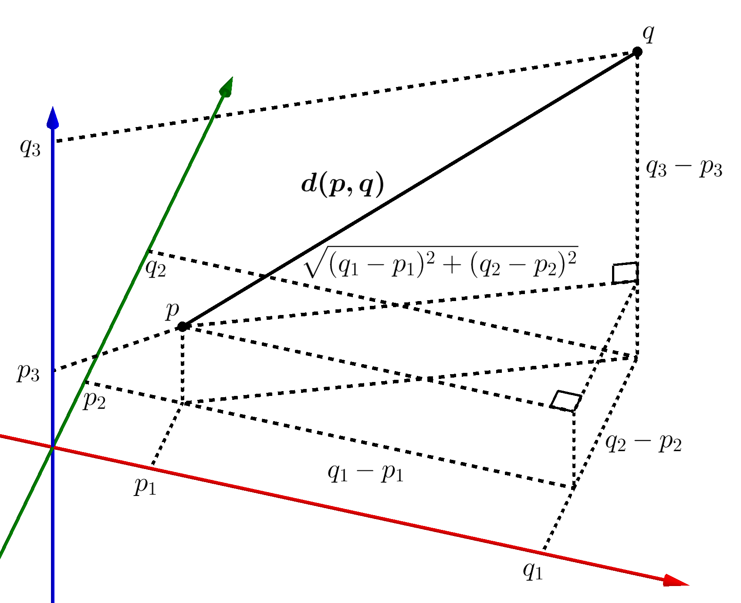

Cross-modal retrieval
How does our approach to cross-modal work?
image/audio
Neural network
Embeddings
Euclidean distance
After calculating Euclidean distance, we can predict Top-k correlated image/audio by comparing each of them.

Slide 20
Cross-modal retrieval
How does our approach to cross-modal work?
image/audio
Neural network
Embeddings
Euclidean distance
After calculating Euclidean distance, we can predict Top-k correlated image/audio by comparing each of them.

Slide 21
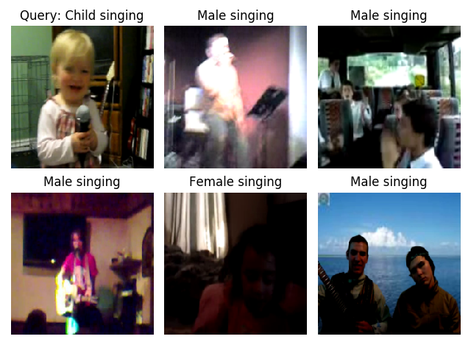
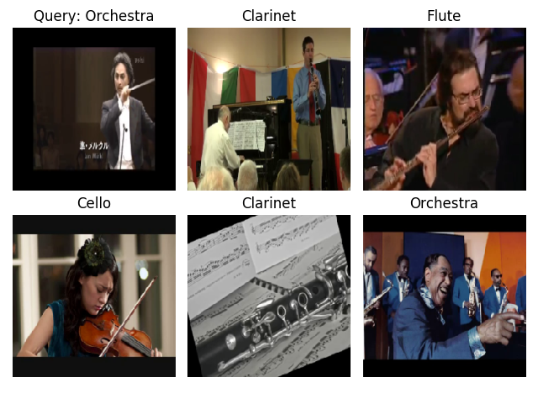
Experiment results
Results of cross-modal
audio-image
image-audio

Slide 22
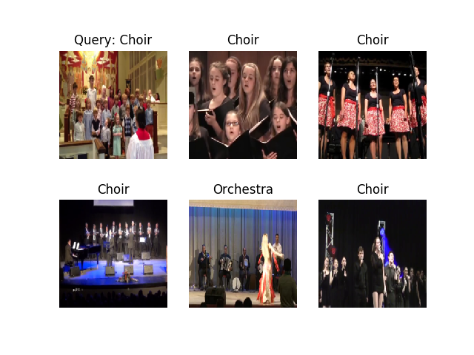
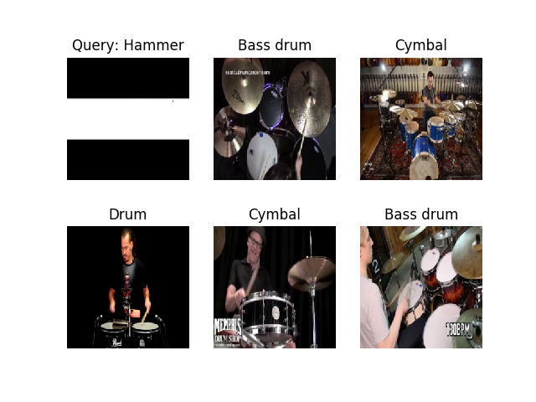
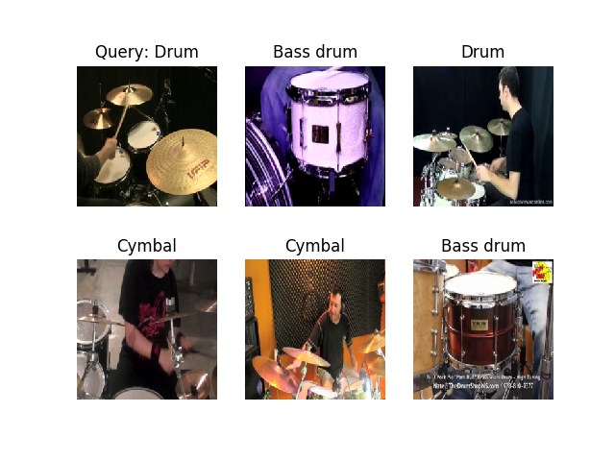
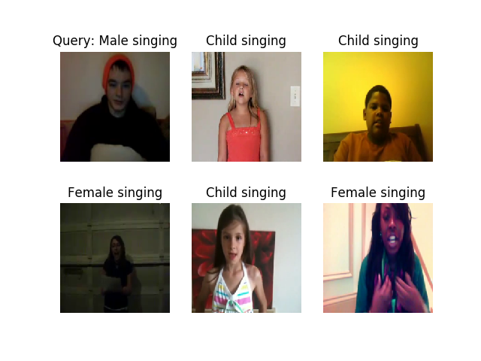
Experiment results
Results of cross-modal
…
audio-image
…
image-audio

Slide 23
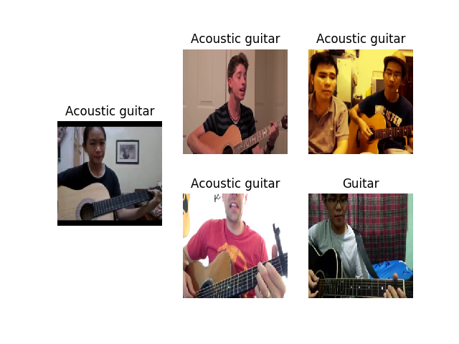
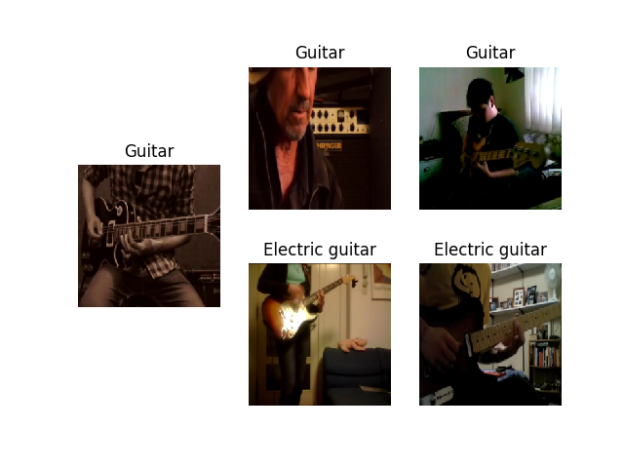
Experiment results
Results of intra-modal
image-image
audio-audio
Query
(image)
query
(audio)
(Image represents the corresponding audio for easier understanding)

Slide 24
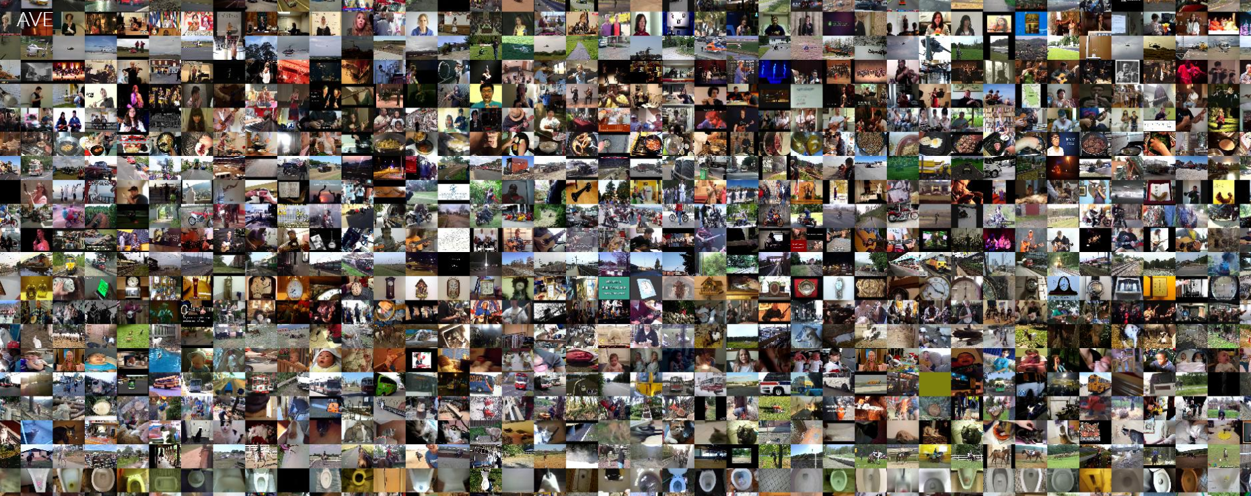
Improvement (+feedback)
We proposed an improvement idea in the project proposal presentation, which uses animal and human voice data for more generalization.
However, after project proposal,
feedback : “Just using two other data classes can’t contribute much to generalization.”
We used additional dataset.
Categories : ~40 general classes(ex. cooking, human voices, vehicles, etc.)
Size : ~4000
AVE-dataset

Slide 25
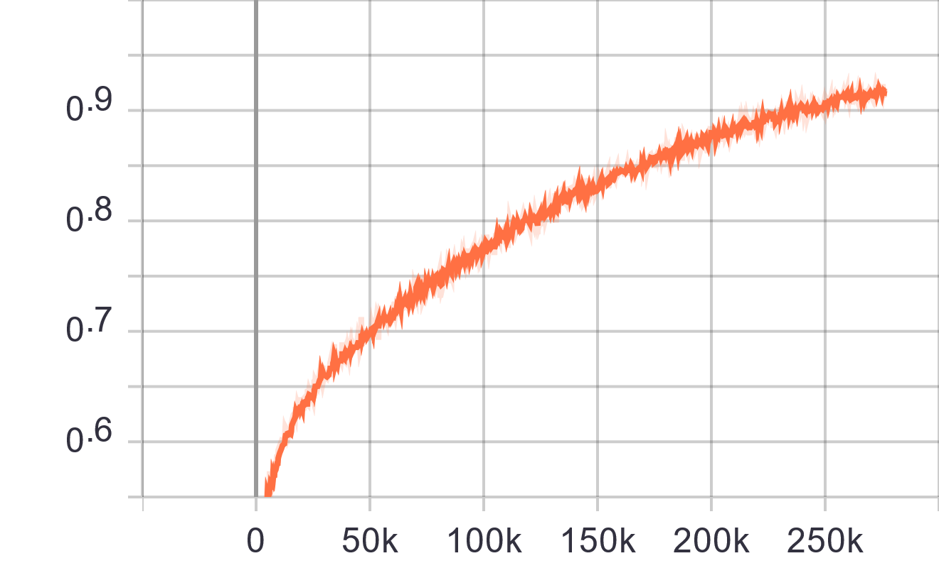
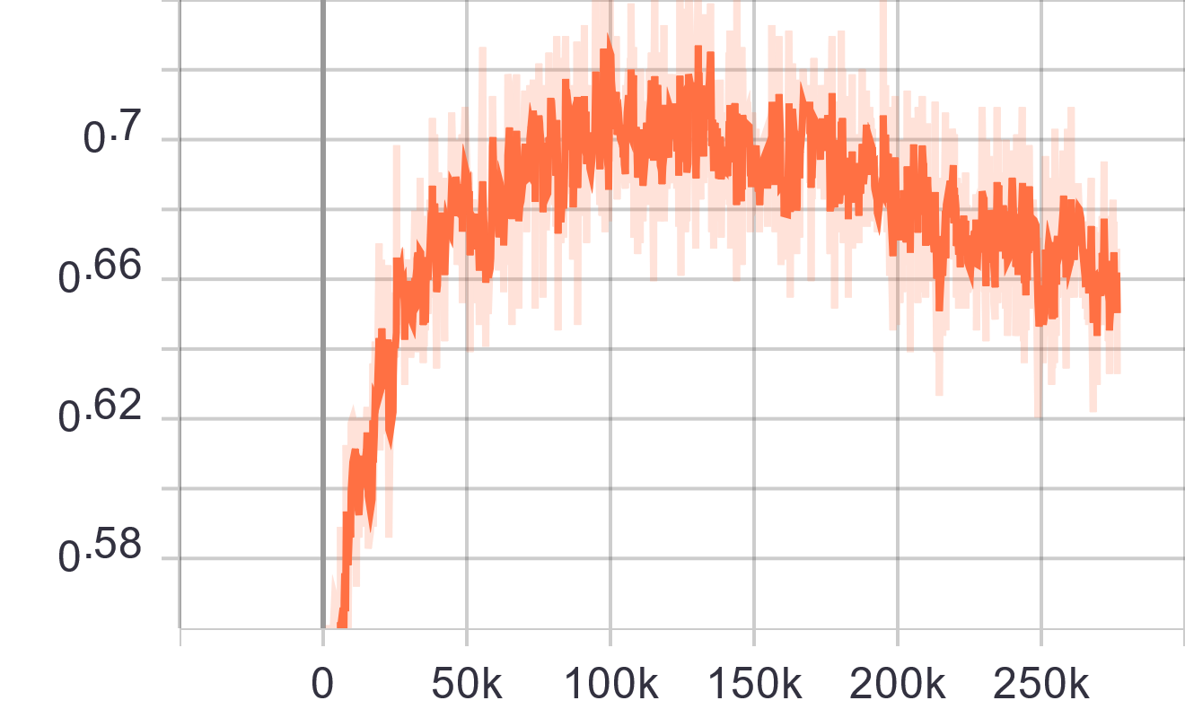
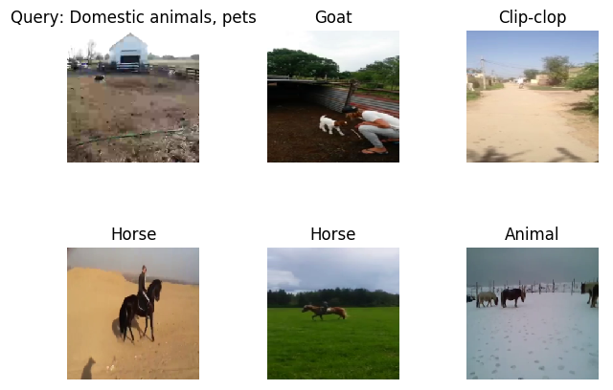
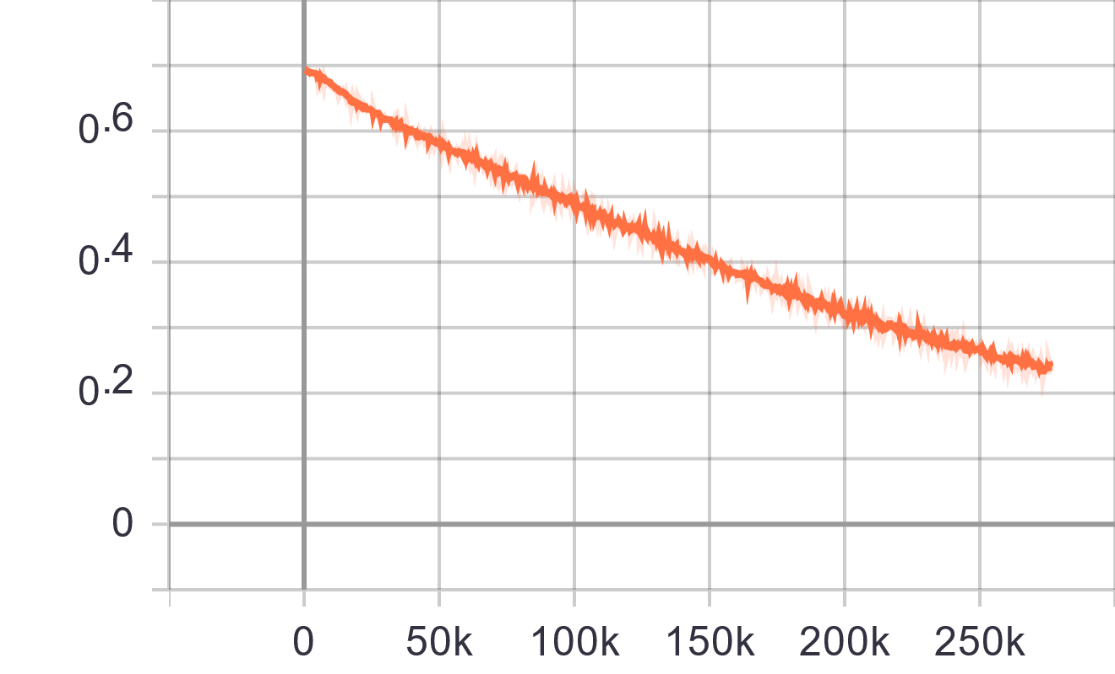
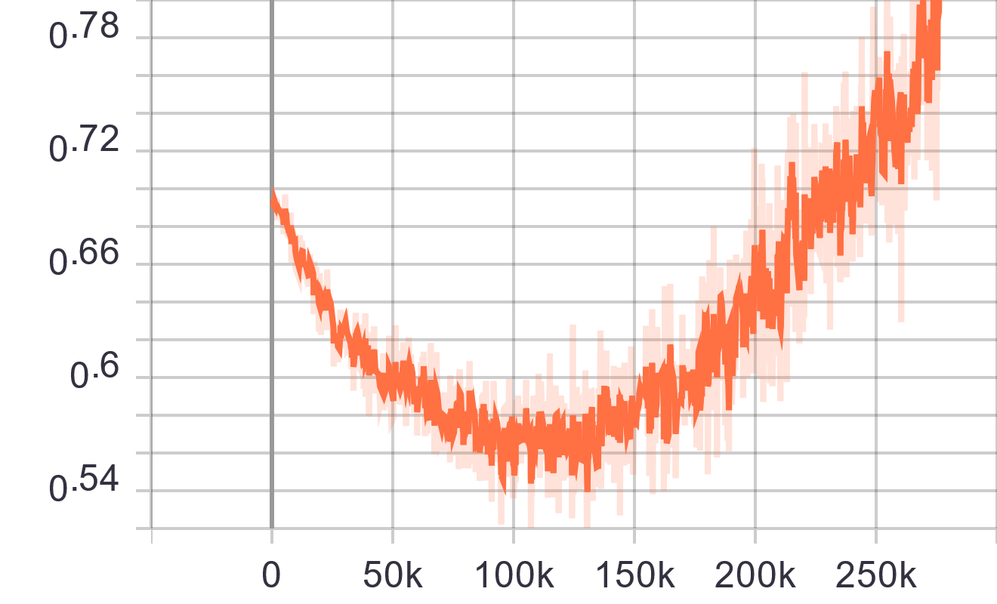
Improvement (+feedback)
Training acc.
validation acc.
Animal
Training loss
validation loss
ex. image-audio

Slide 26
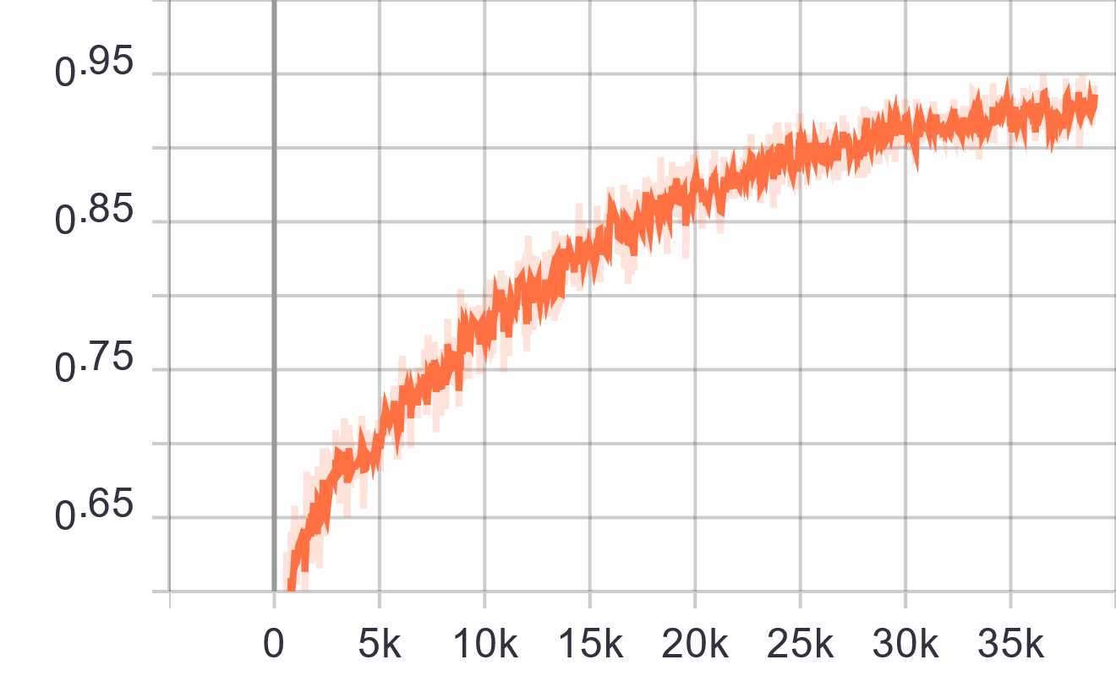
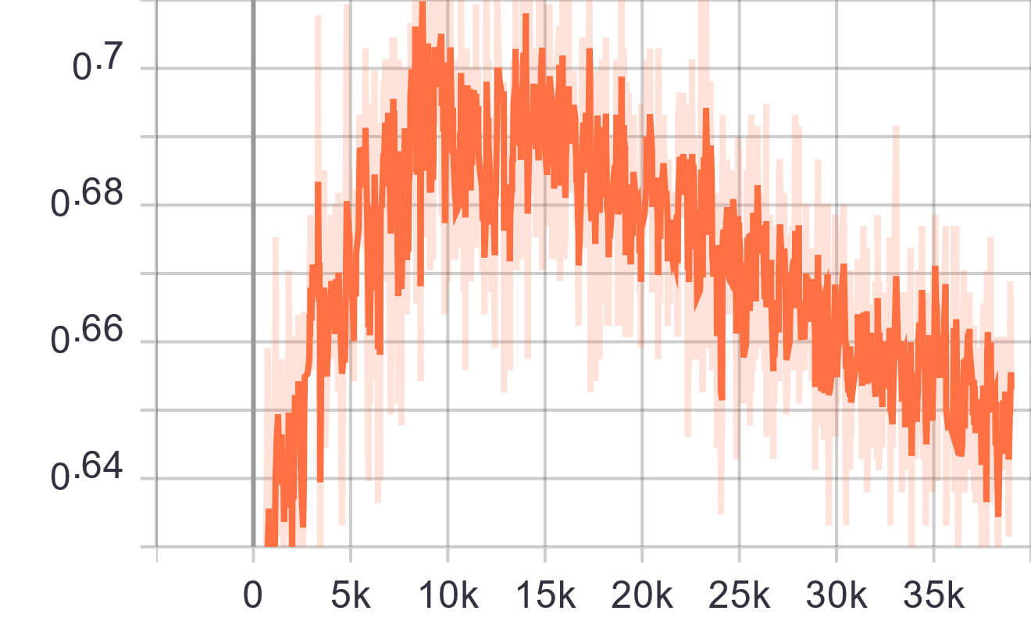
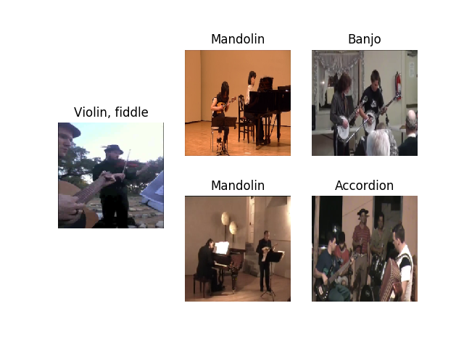
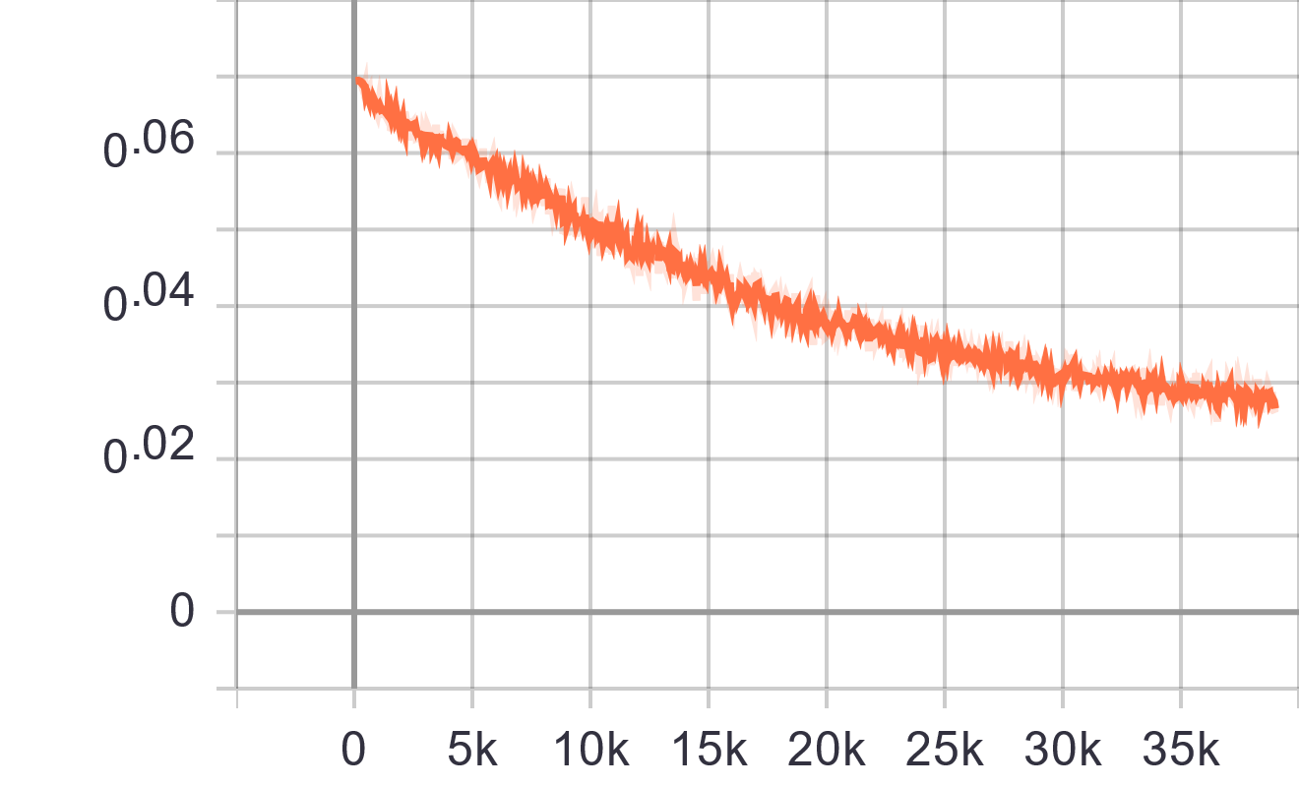
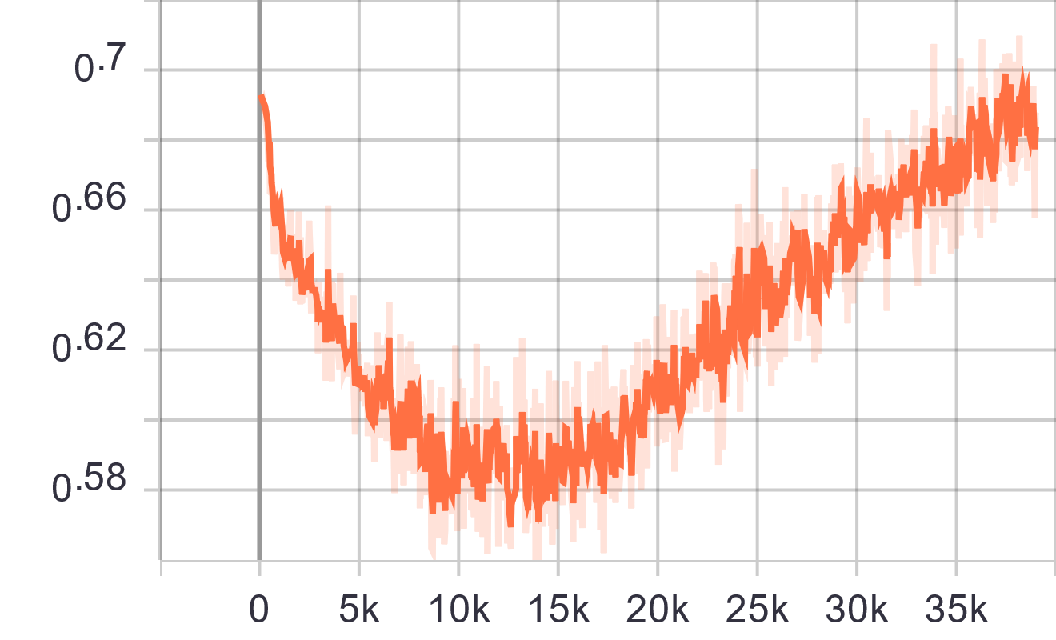
Improvement (+feedback)
Training acc.
validation acc.
AVE-dataset
Training loss
validation loss
ex. image-image

Slide 27
Plan of improvement
Current improvement
Using a specific data class : Animal class
Additional dataset : AVE-dataset
Future plan of improvement
Increasing a performance : By applying Augmentation on image and spectrogram
Applying new evaluation metric : nDCG@K + mAP / R@K

Slide 28
Thank you

